Slide 1
BBC micro:bit - Python Programming
Steve Case

Slide 2
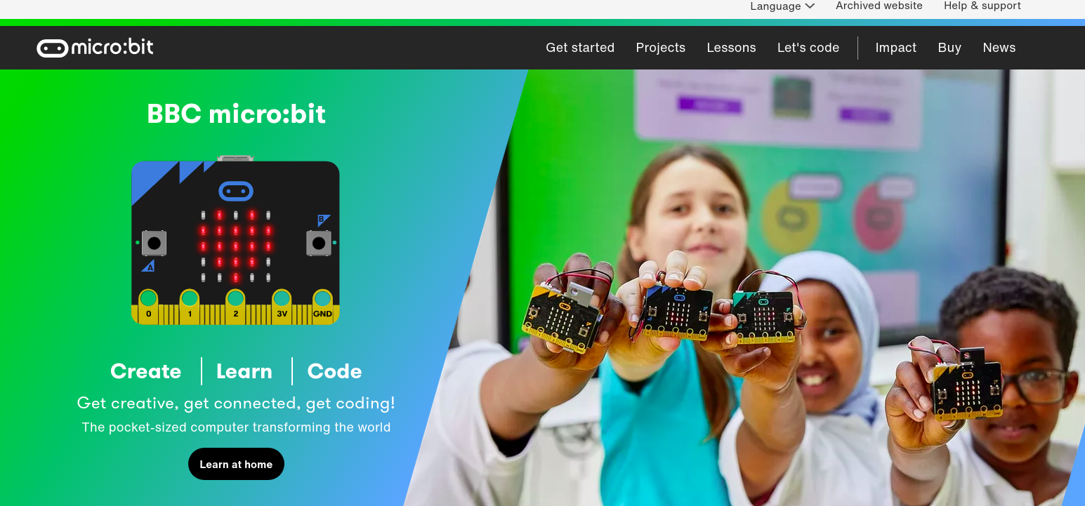
BBC micro:bit

Slide 3
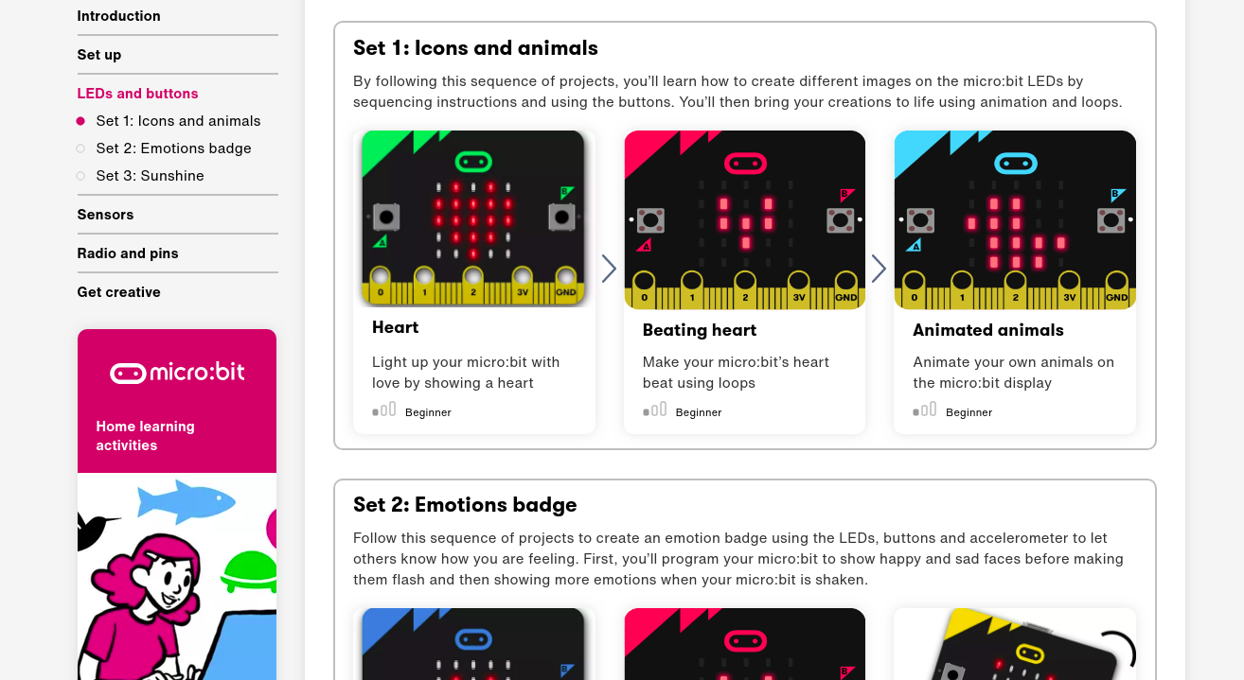
BBC micro:bit

Slide 4
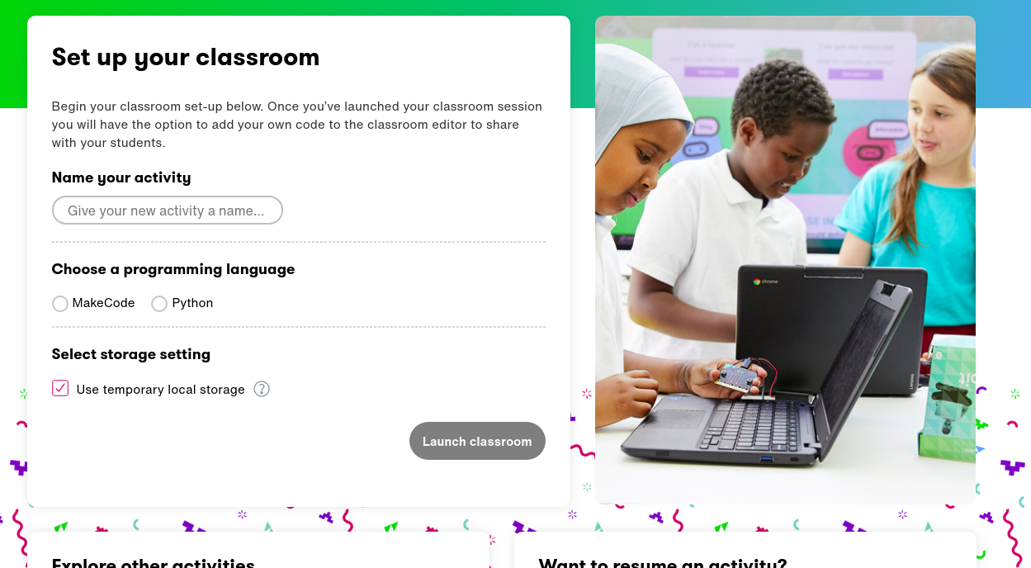
BBC micro:bit

Slide 5
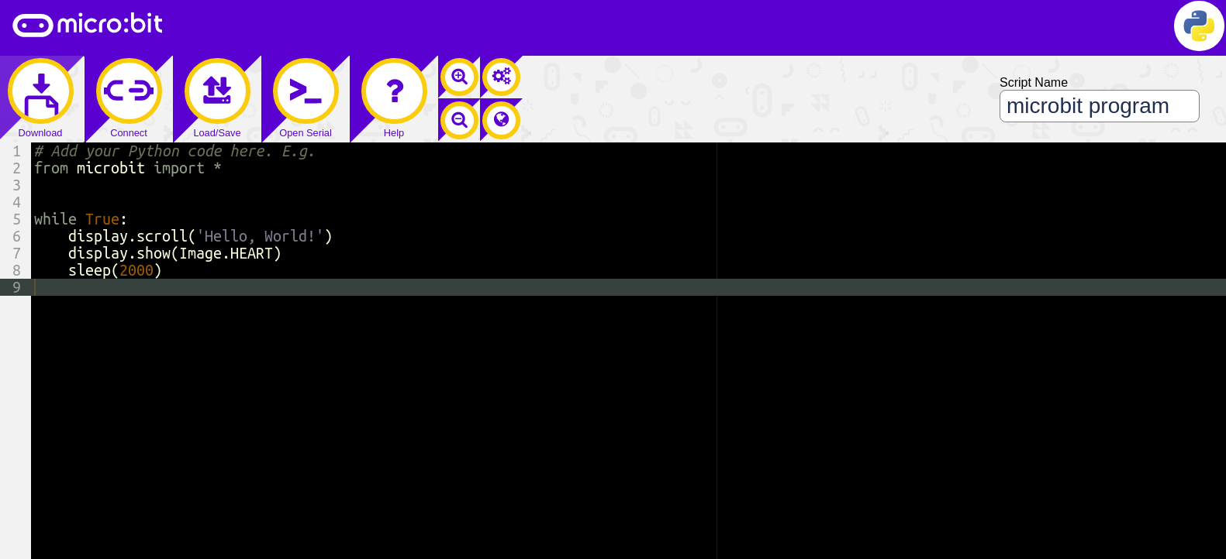
BBC micro:bit Python Editor

Slide 6
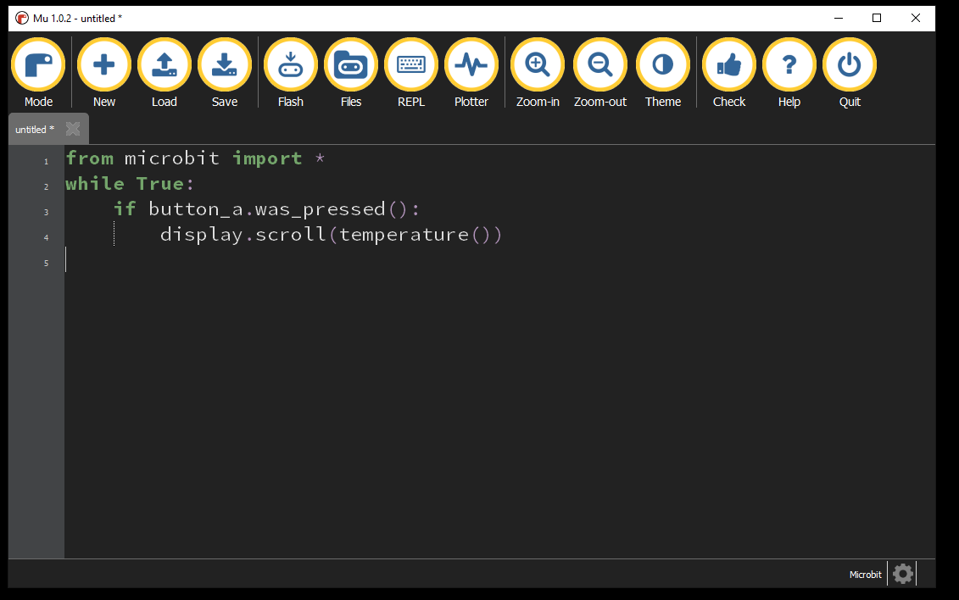
BBC micro:bit Mu Python Editor
Notes:
This is the editor that we suggest students use for editing their work. It has syntax checking and code-completion to make things a bit easier.
For online work in groups, we’ll use the bbc:microbit editor.

Slide 7
while_loop.py
# Bring in the libraries that you need
from microbit import *
i = 1
while i < 5: # execute loop 5 times?
display.show(Image.SKULL)
sleep(500)
display.clear()
sleep(500)
i = i + 1

Slide 8
Anatomy of bbc:microbit python programs
# For-Loop 1
#
# s.case 10/26/20
#
#
# Bring in the libraries that you need
from microbit import *
# Execute loop 5 times
for i in range(5):
display.show(Image.HAPPY)
sleep(500)
display.clear()
sleep(500)
Comments
Libraries
Running program

Slide 9
Python Basics - Variables
>>> i = 1
>>> print(i)
1
>>> j = 2.
>>> print(j)
2.0
>>> name = “Coco”
>>> print(name)
Coco
In this case, i is an integer. Think of integers as counting numbers.
In this case, j is an floating point number. Think of it as a number with a fractional part.
In this case, name is a string of collected characters.

Slide 10
for_loop.py
# Bring in the libraries that you need
from microbit import *
# Execute loop 5 times
for i in range(5):
display.show(Image.HAPPY)
sleep(500)
display.clear()
sleep(500)

Slide 11
while_loop.py
# Bring in the libraries that you need
from microbit import *
i = 1
while i < 5: # execute loop 5 times?
display.show(Image.SKULL)
sleep(500)
display.clear()
sleep(500)
i = i + 1

Slide 12
temperature1.py
from microbit import *
while True:
if button_a.was_pressed():
display.scroll(temperature())
elif button_b.was_pressed():
display.scroll("Hi My name is Steve ")

Slide 13
temperature2.py
from microbit import *
while True:
if button_a.was_pressed():
degF = (9 / 5 * temperature()) + 32
display.scroll(degF)

Slide 14
BBC micro:bit Other Topics
The microbit is based on Micropython.
When researching, you will find examples based on CircuitPython.
CircuitPython is from AdaFruit and is a “fork” of MicroPython.
CircuitPython programs are NOT compatible with the microbit.
This does not make AdaFruit “evil” or bad.
AdaFruit is making more fantastic products available based on Python which makes creating electronics projects easier than ever.
MicroPython was developed first, so you may see AdaFruit references to early MicroPython projects.

Slide 15
Reference material
Adafruit Industries: www.adafruit.com
Gemma M0 learning: www.learn.adafruit.com/adafruit-gemma-m0?view=all
Sparkfun electronics: www.sparkfun.com
Mu-Editor Installation:
https://codewith.mu/en/download
Seminar Slides:
https://docs.google.com/presentation/d/1-rhsECbdl-_QQHVEifSHUANQlVRY3bAzd5QX7KLlMLc/edit?usp=sharing
Python:
https://www.w3schools.com/python/default.asp
https://www.python.org/ (advanced full reference for Python)
https://wiki.python.org/moin/BeginnersGuide (still pretty advanced)
Electronics basics videos

